Slide 1
The MegaDerm 3000
Team 9
Kristen Hagan
Mahy Hussain
Laura Kenyon
Thomas Leahy

Slide 2
Process Overview

Slide 3
Process Overview
Perform single-image Analysis on every image
Prompt user to crop the ruler and mole
Detect the
lesion border
Perform time-lapse analysis for individual data collected from every image
Border Contour Map
Change in area over time
Change in asymmetry over time
Change in color variation over time
Find the pixel/mm conversion factor
Calculate lesion
area
Prompt user to input image stack
Calculate asymmetry coefficients
Calculate Color
Variation Coefficients

Slide 4
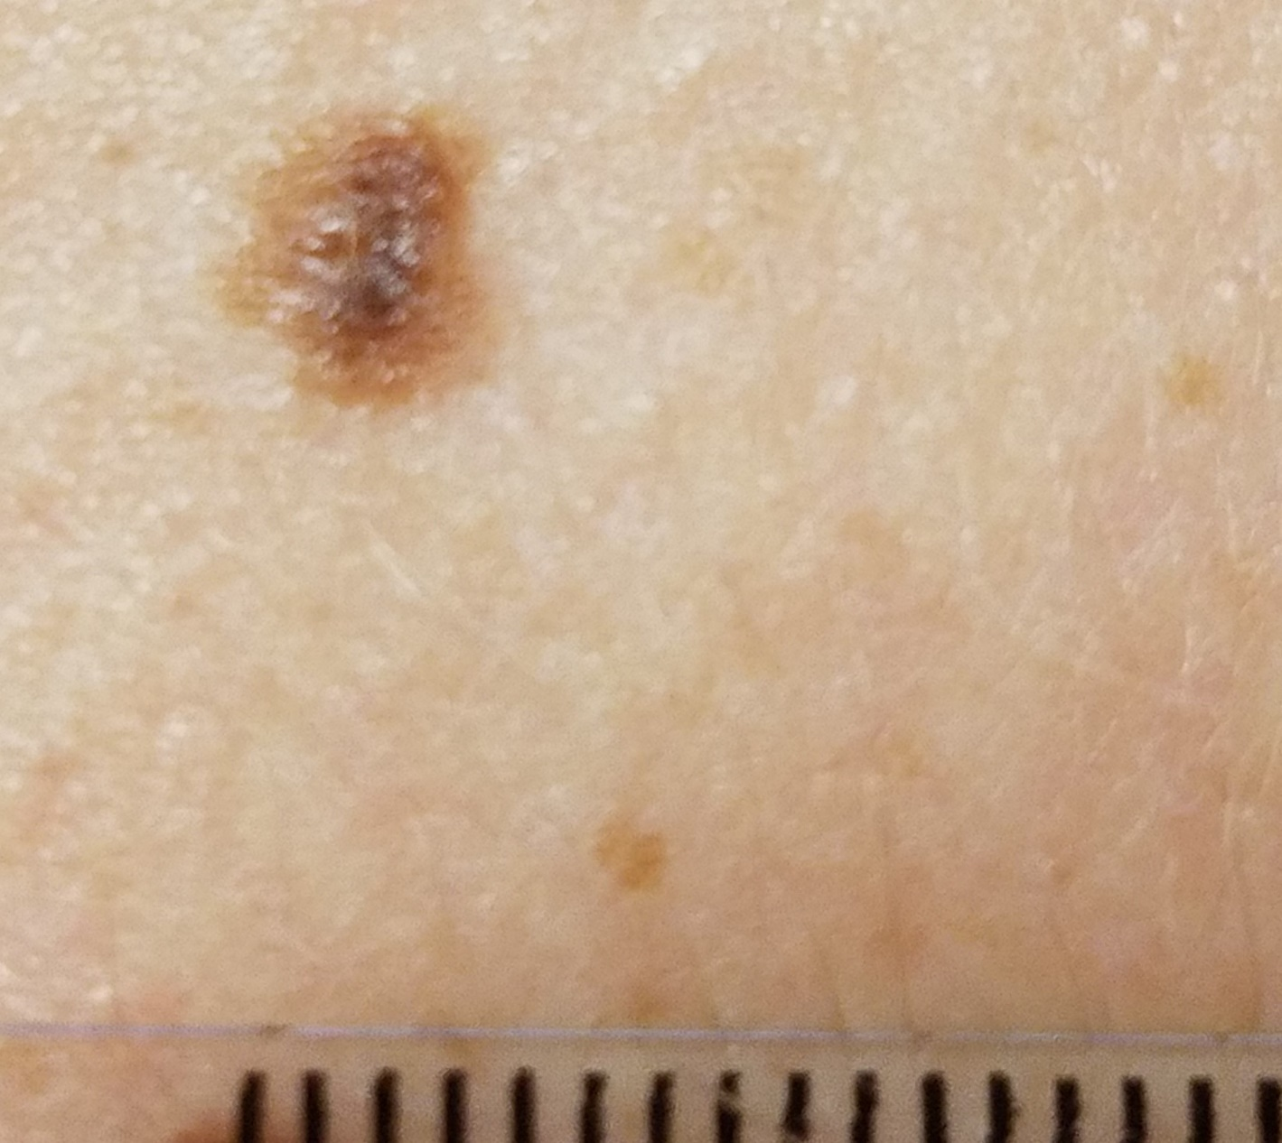
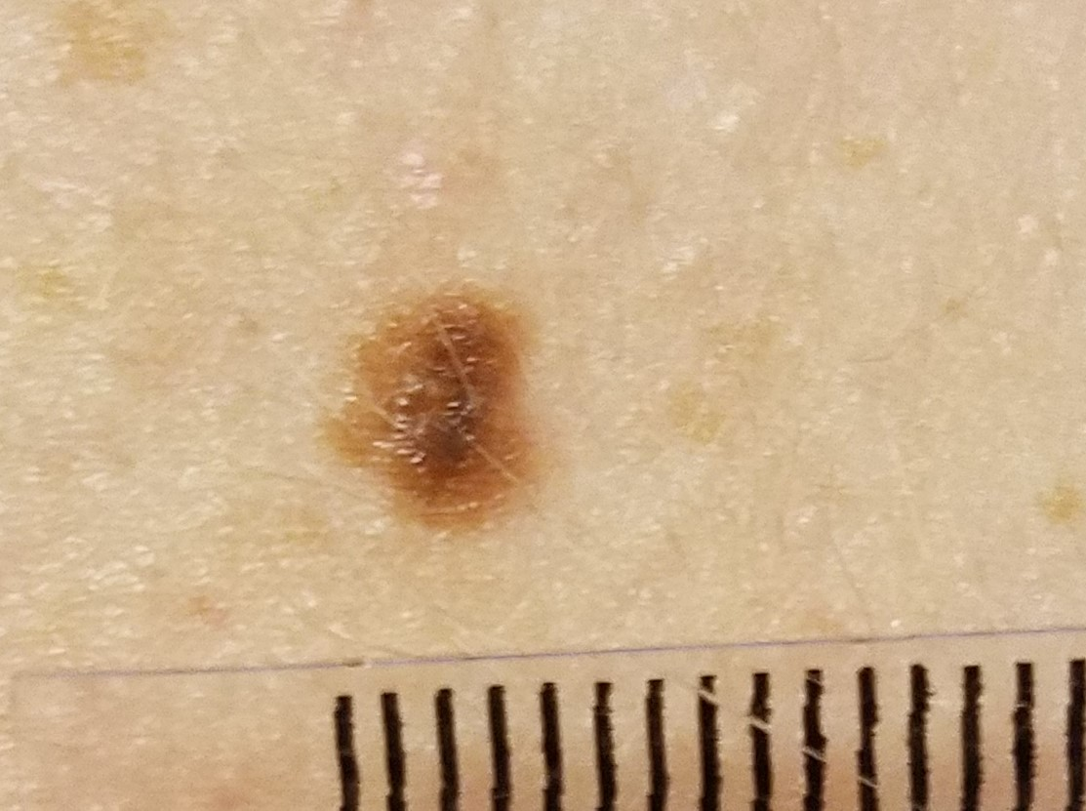
Input Image Stack
Images requires lesion and millimeter ruler at same focal length for pixel-mm conversion factor calculation

Slide 5

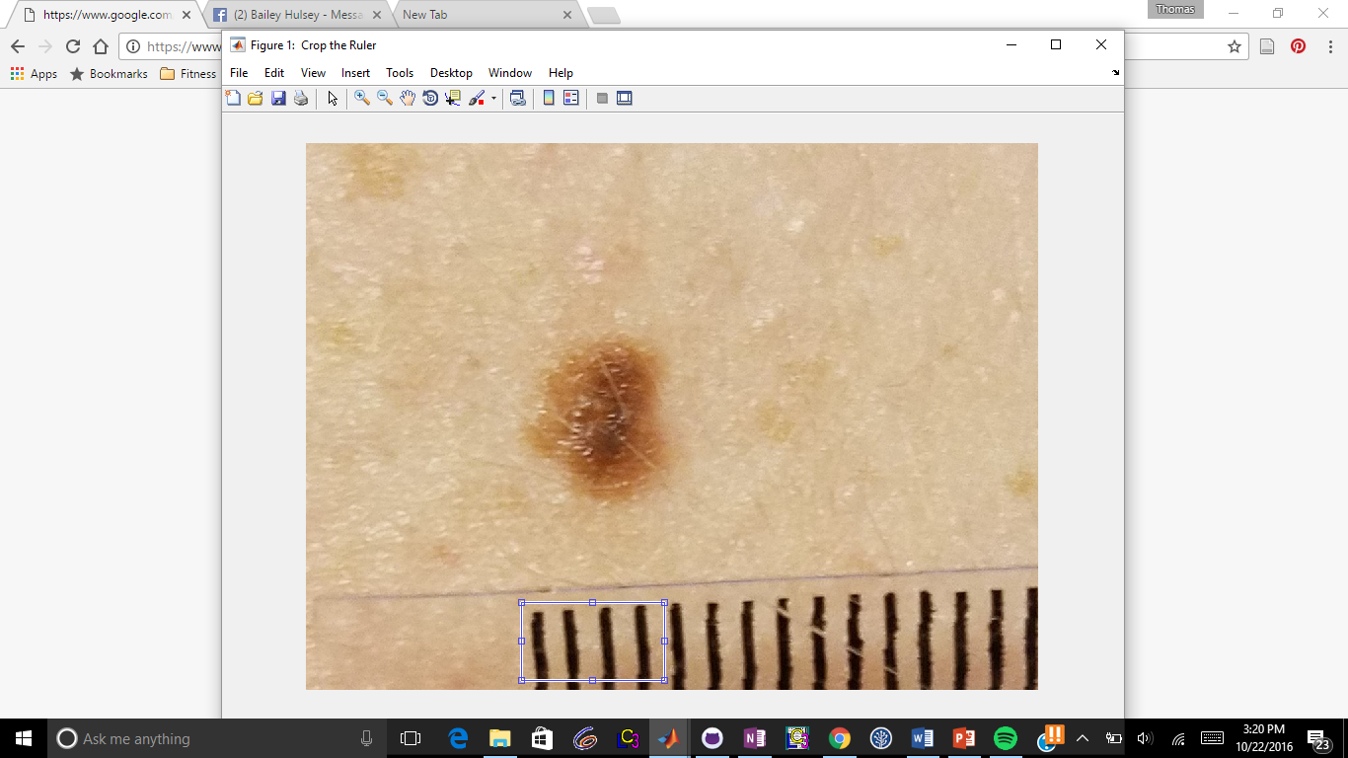
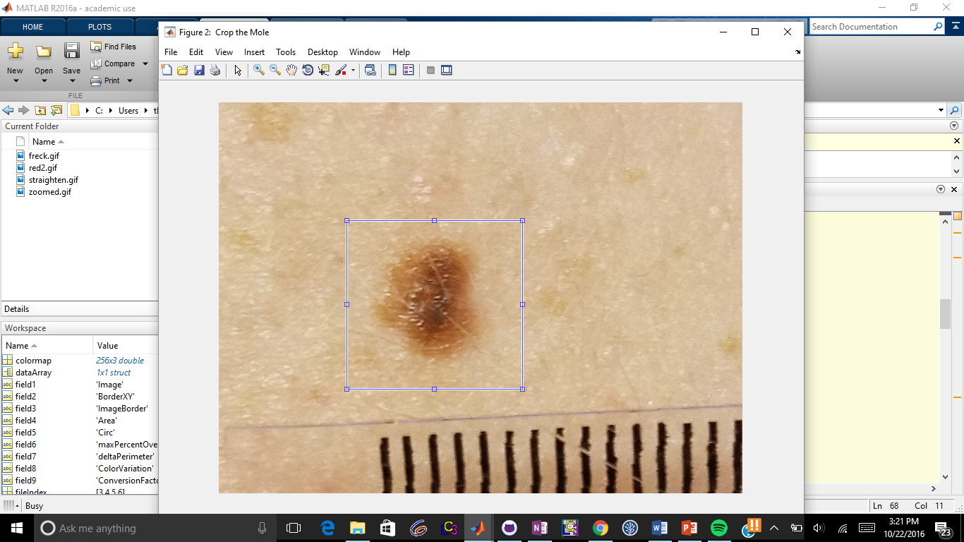
User Input - Cropping
Ruler Crop
Mole Crop

Slide 6
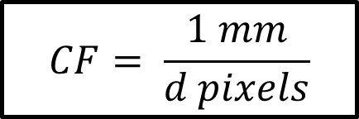
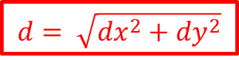
Finding the mm/pixel conversion factor (CF)
$$d= \sqrt{{dx}^{2}+{dy}^{2}}$$
dy
dx
$$CF= \frac{1 mm}{d pixels}$$
Notes:
$$d= \sqrt{{dx}^{2}+{dy}^{2}}$$
$$d= \sqrt{{dx}^{2}+{dy}^{2}}$$
$$CF= \frac{1 mm}{d pixels}$$

Slide 7
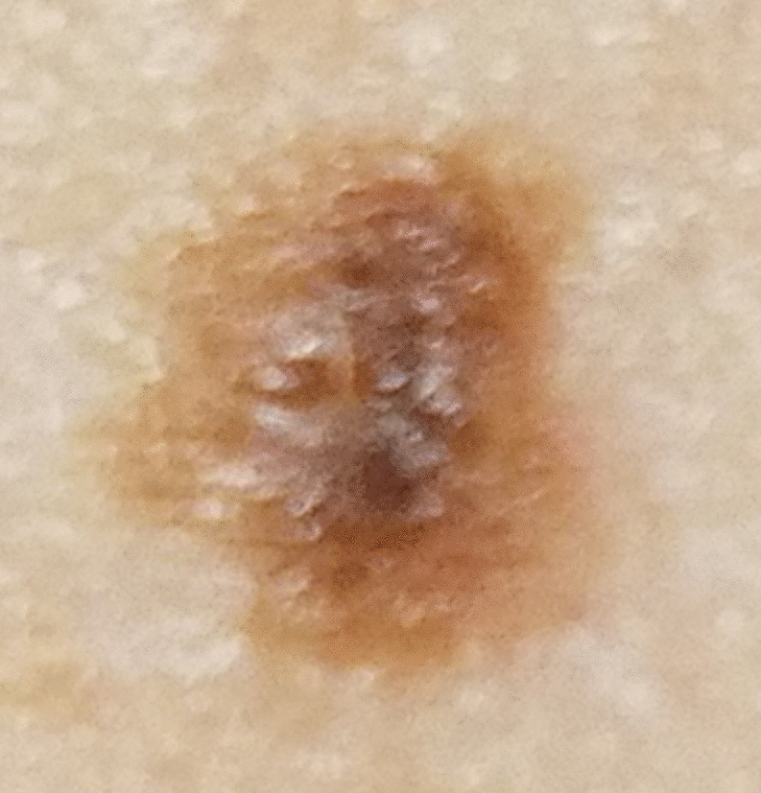
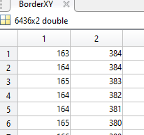
Detecting the lesion border
XY Coordinates for the Border
Binarized Image

Slide 8
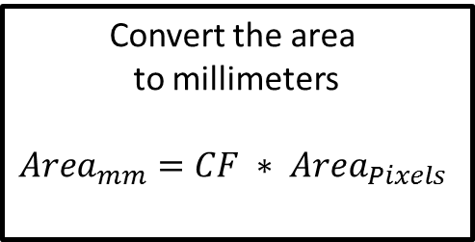
Calculate the lesion area
Binarized Image
Convert the area to millimeters
$${Area}_{mm}=CF ∗ {Area}_{Pixels}$$
Sum the number of pixels considered part of the mole

Slide 9
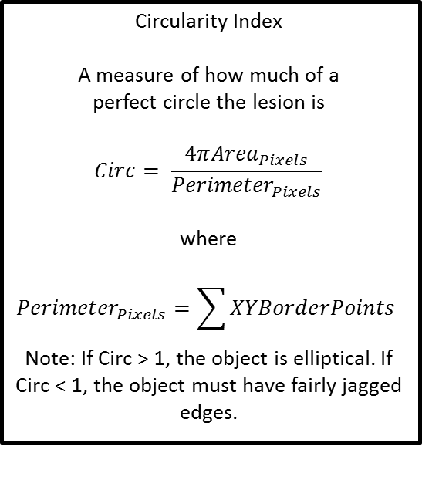
Calculate asymmetry coefficients
Plane of Symmetry Testing
Rotate through θ from 0° to 179°.
Overlap the image across the line of symmetry and calculate the percent match.
Output the highest percent match as the symmetry coefficient
Difference in Elliptical Perimeter
Fit the object to an ellipse based off of major and minor axes
Calculate the difference in perimeters between the two as a percentage (object perimeter as described previously). A higher percentage value means the object has more jagged edges.
Circularity Index
A measure of how much of a perfect circle the lesion is
$$Circ= \frac{4π{Area}_{Pixels}}{{Perimeter}_{Pixels}}$$
where
$${Perimeter}_{Pixels}=\sum{XYBorderPoints}$$
Note: If Circ > 1, the object is elliptical. If Circ < 1, the object must have fairly jagged edges.
θ

Slide 10
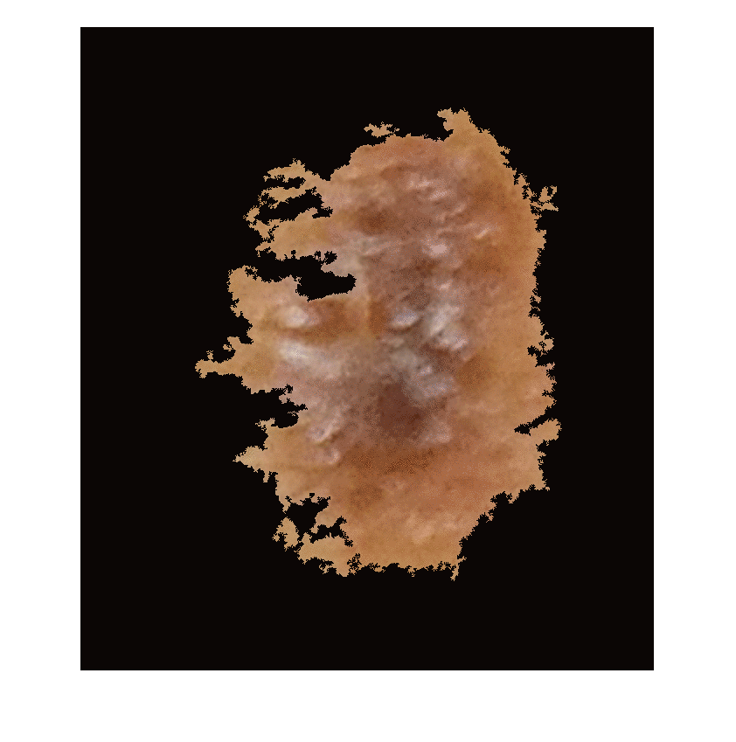
Calculate color variation
Mask mole with binarized image
+ = =
Create standard deviation plot to show the heterogeneity of the mole coloring
White areas: 3x3 area around pixel contains different colors than center pixel

Slide 11
Create RGB Histograms for Each Image
Create RGB Image from Indexed Image
Isolate R, G, B planes
Plot number of pixels containing a certain R, G, or B value

Slide 12
Timelapse Creation:
Border Contour
Find the image with the largest area
Find the centroids of each image and find each border point’s distance from the centroid
Use the CF to scale the distances to each border point
Plot each new border on the same plot

Slide 13
Time-lapse Creation:
Area

Slide 14
Time-lapse Creation:
Asymmetry

Slide 15
Time-lapse Creation:
Color Variation
Kristen do this, idk wat it is

Slide 16
Validation

